Slide 1

Gatorscribe
A real-time music transcriber

Slide 2
Idea
Robust solution to transcribing a monophonic composition played from any instrument or voice
Designed to be a plug-and-play product for any experience level
Provides customization for song title, key signature, time signature, BPM, and playback instrument

Slide 3
Goals
Achieve monophonic pitch detection for the fundamental frequency of any instrument or voice
Create a simple user interface using a touch screen LCD
Automatic file transfer of MIDI file generated for display and playback of the transcribed sheet music

Slide 4
Processor Decision
ATSAMV71Q21 ARM Cortex M7
Speed 300 MHz
Communication SPI, TWI, EBI
Rapid Development Xplained Kit
Onboard codec
Audio I/O
Micro-USB
LCD header
Example Code
Familiarity Atmel Studio

Slide 5
Block Diagram

Slide 6
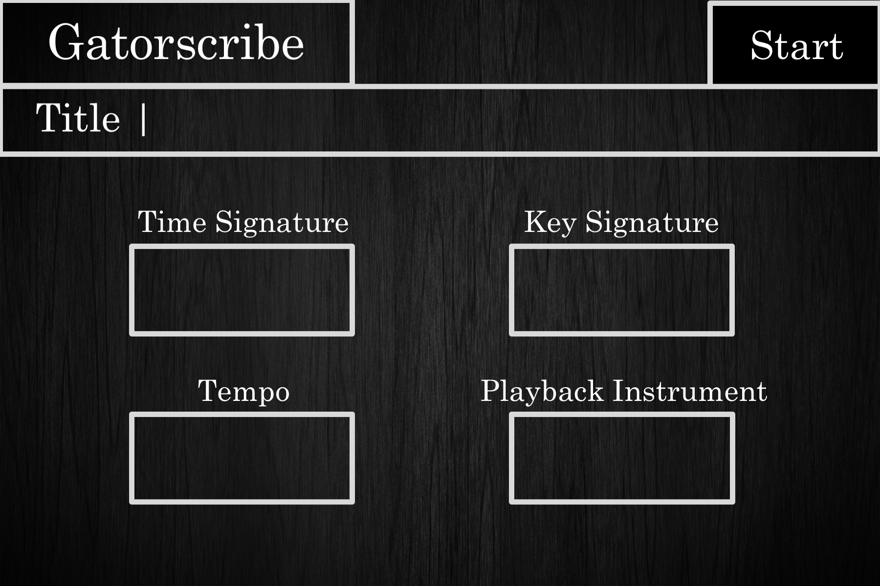
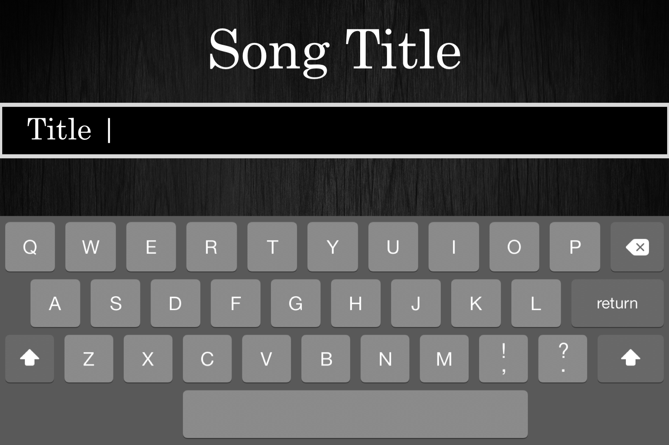
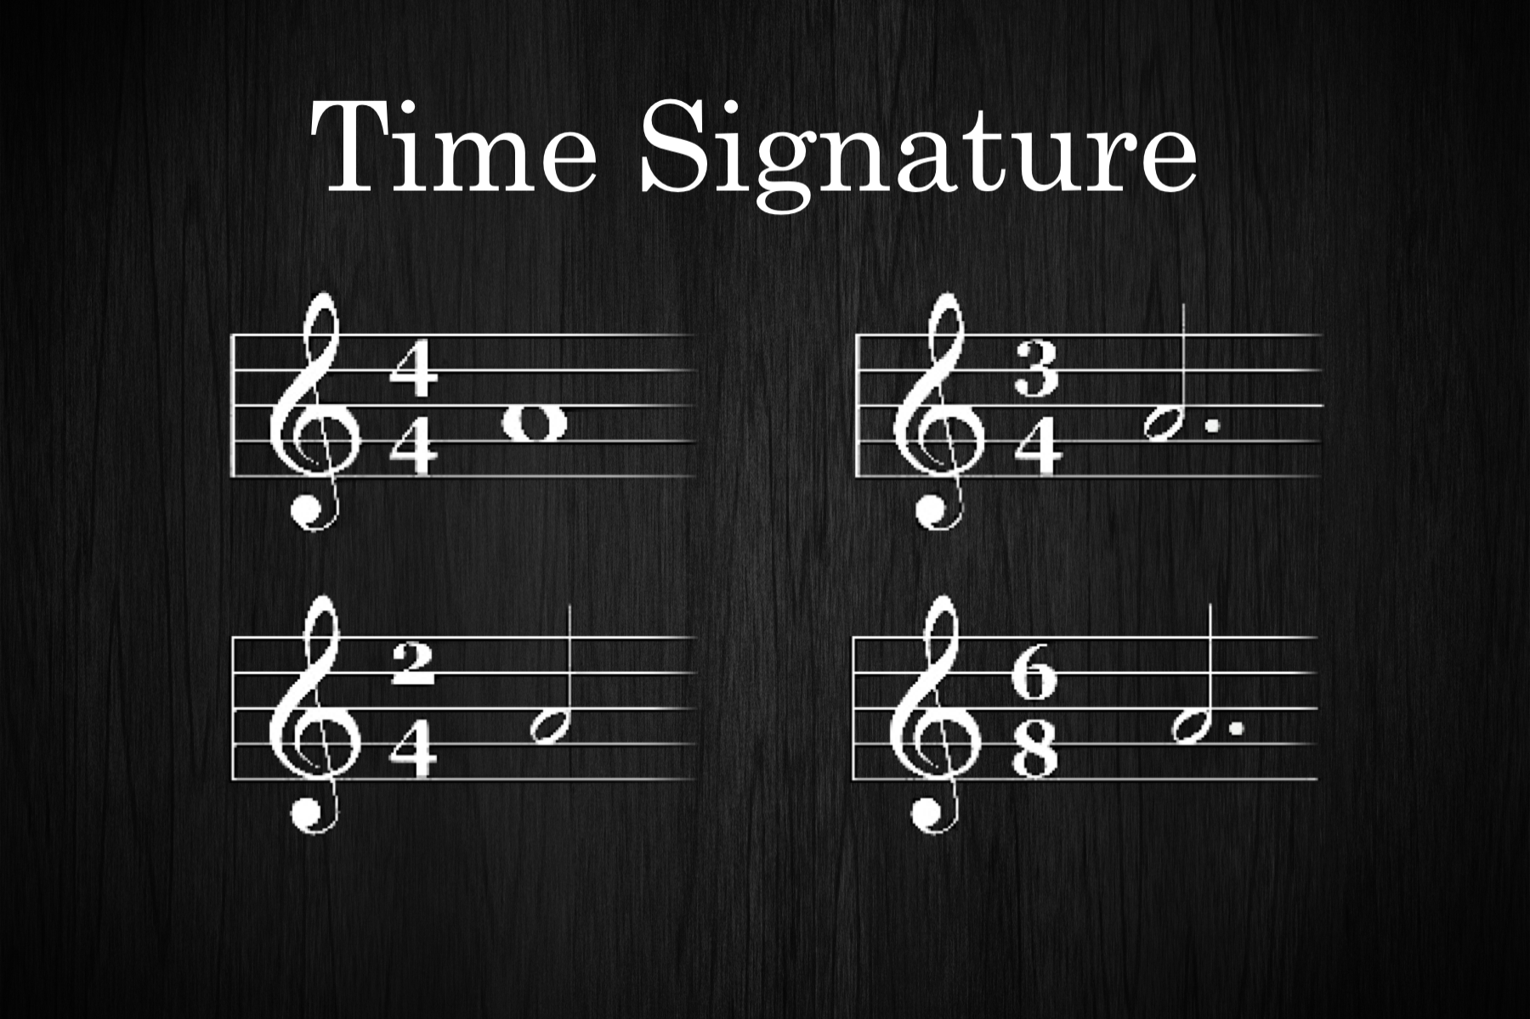
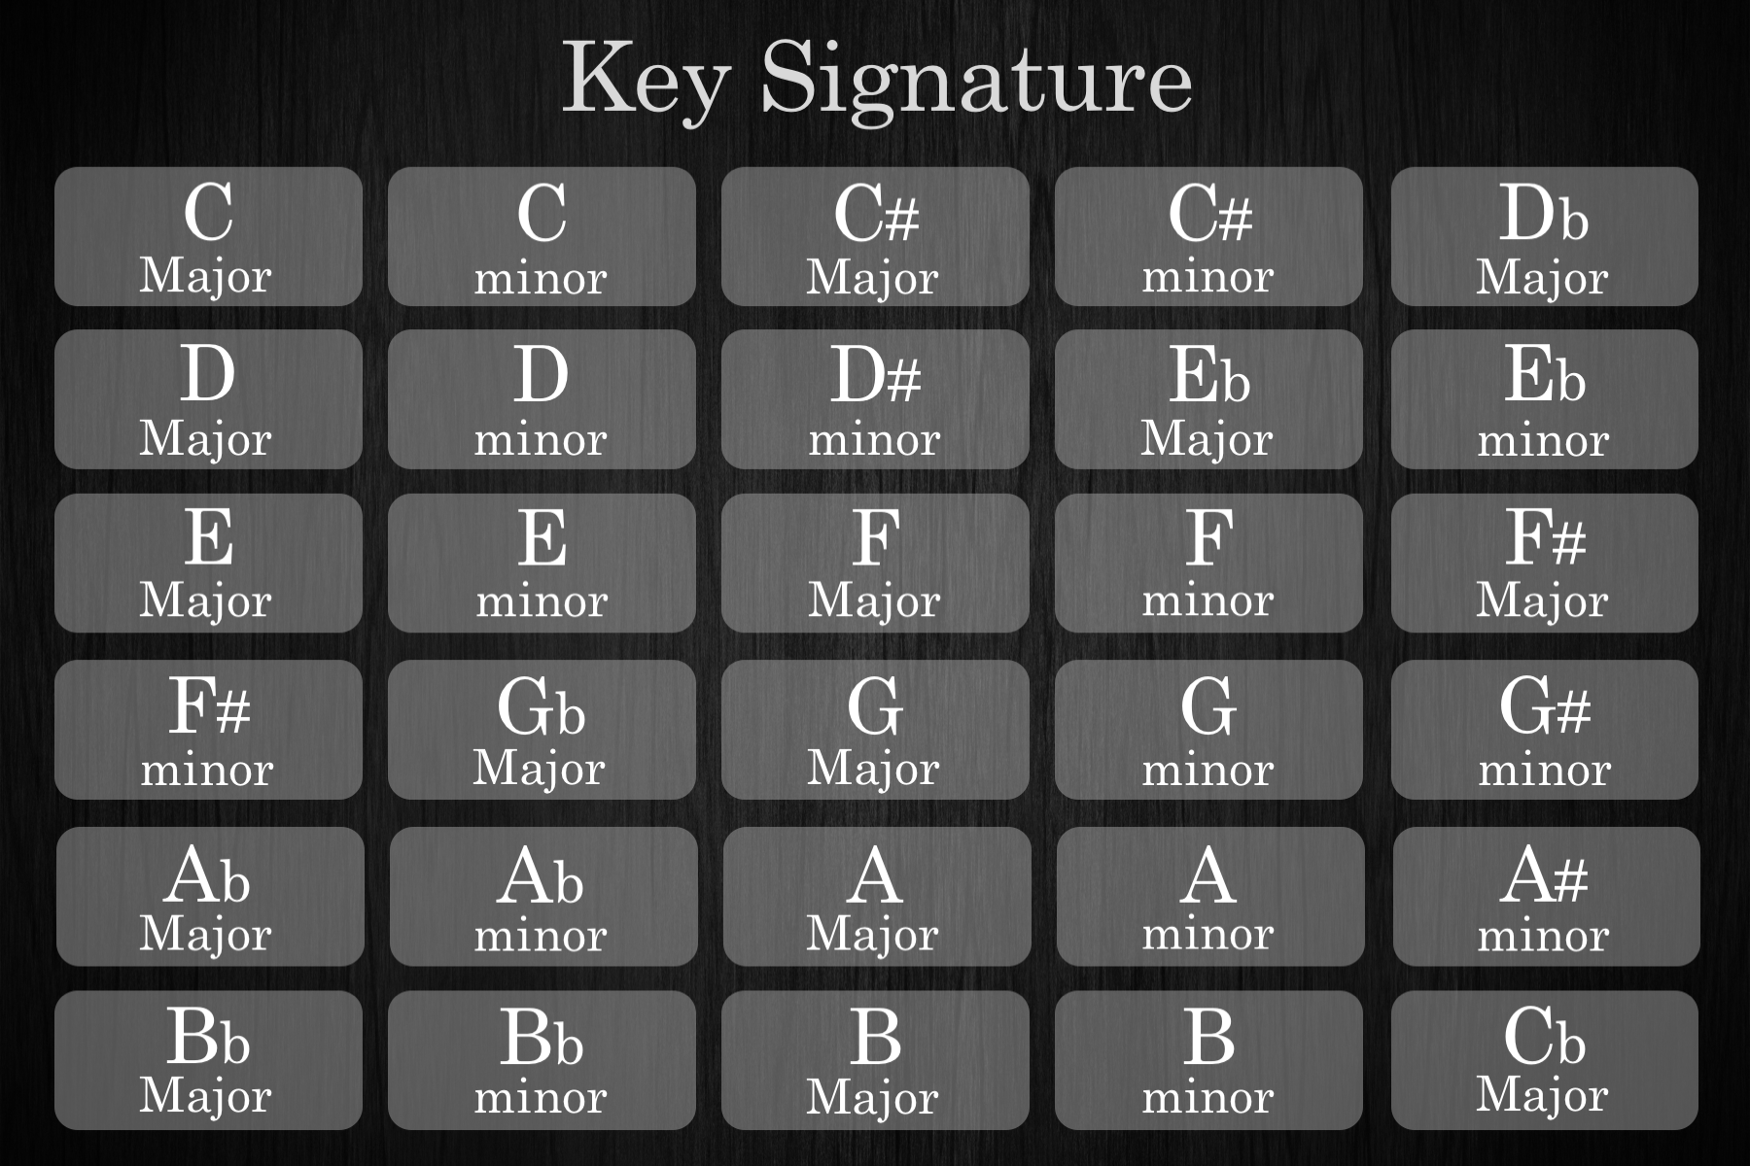
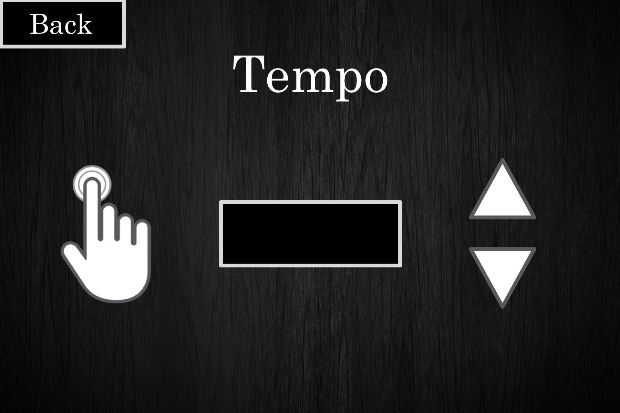
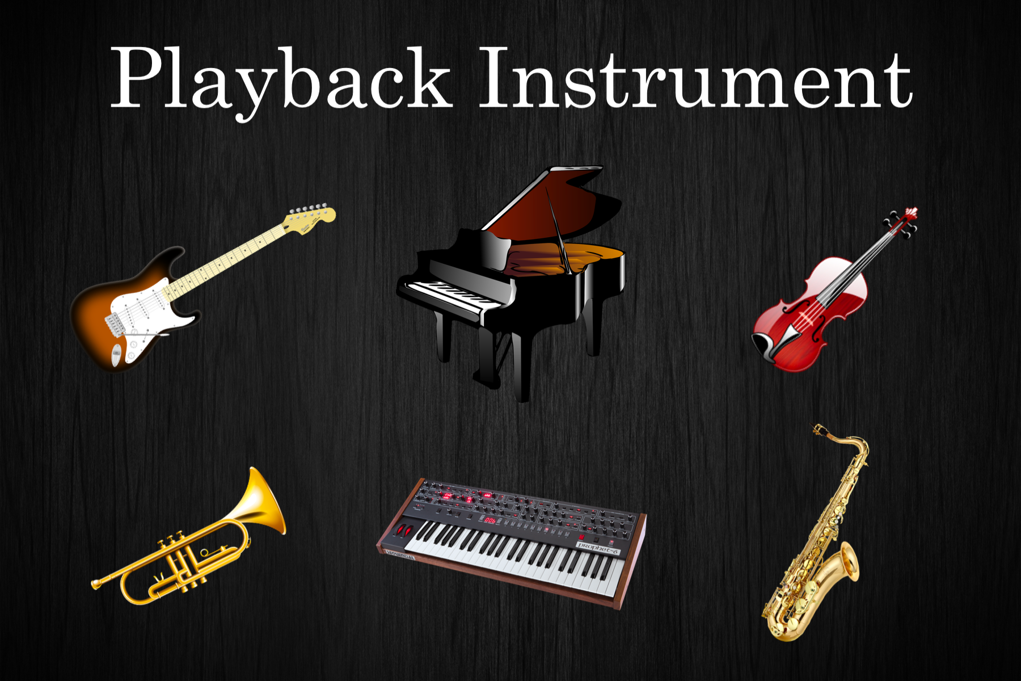
User Interface

Slide 7
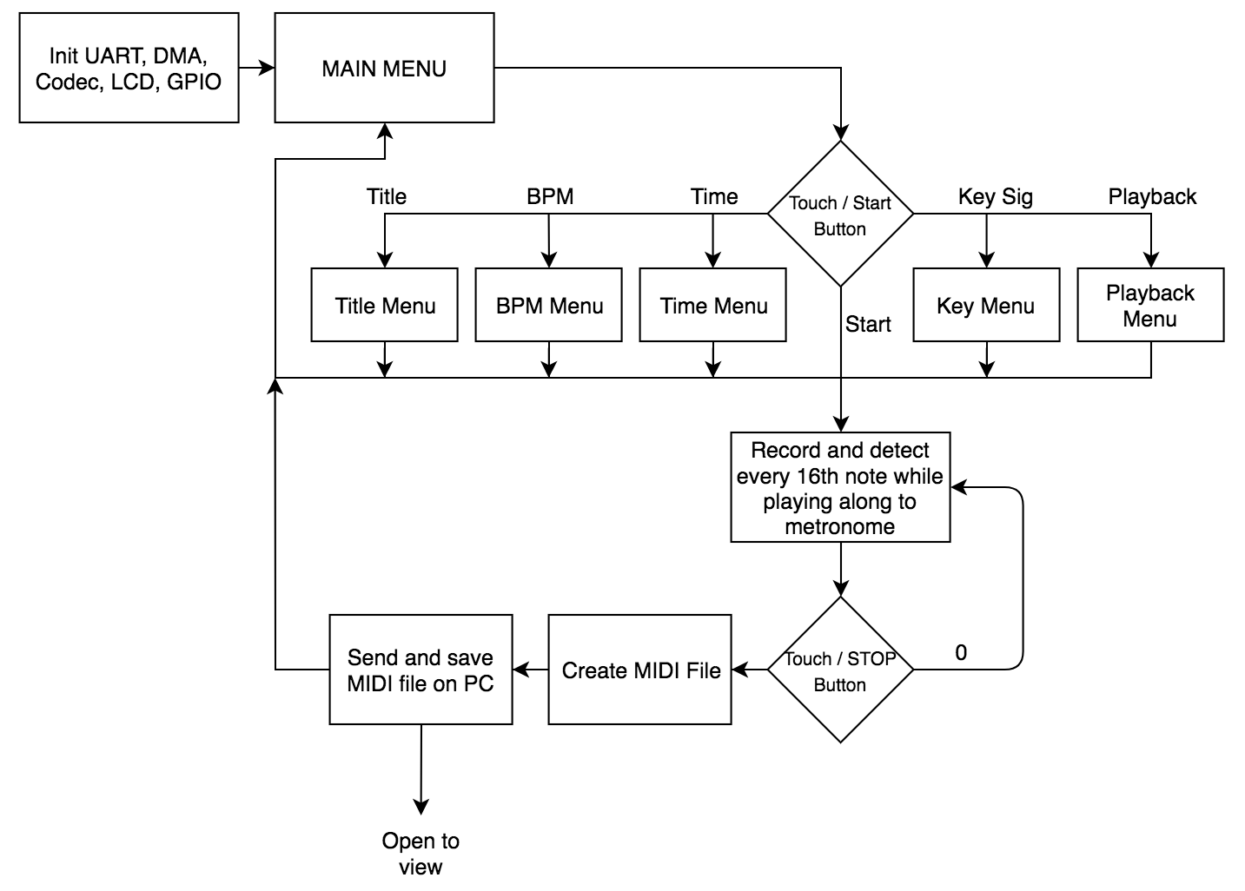
Flowchart

Slide 8
YIN Algorithm
Pitch detection determines the fundamental frequency of the signal
Computation complexity in time domain is O(N²), so we use a Fourier transform to perform the algorithm on the autocorrelation, achieving O(3*N*log₂(N))

Slide 9
MIDI File Creation
Log of MIDI events recorded
Pitch
Velocity
Rhythm
External PC runs Python script which waits to receive data
Standard MIDI track file sent to external PC through UART
Python script formats and saves MIDI file

Slide 10
Responsibilities
Danny
DSP
Pitch Detection
MIDI Transcription
Automation script
Altium
GUI Design
LCD
Tyler
Altium
GUI Design
Audio Amplifiers
Solidworks
Foot switches

Slide 11
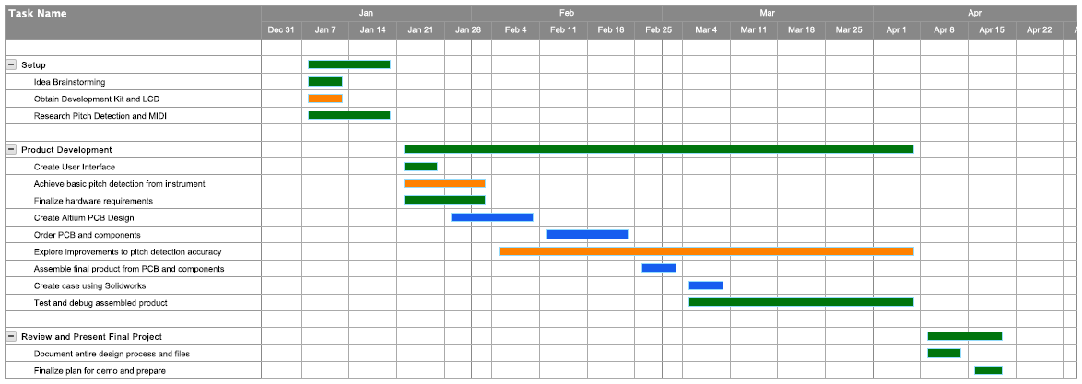
Gantt Chart

Slide 12
Demo
Showcase successful transcription from different instruments
Demonstrate user interface using touchscreen LCD
Perform automatic file transfer from board to computer through USB
Display and playback transcribed sheet music on computer monitor

Slide 13
Stretch Goals
Polyphonic music transcription
Java application for user interface as opposed to LCD
Harmonizer option

